Slide 1
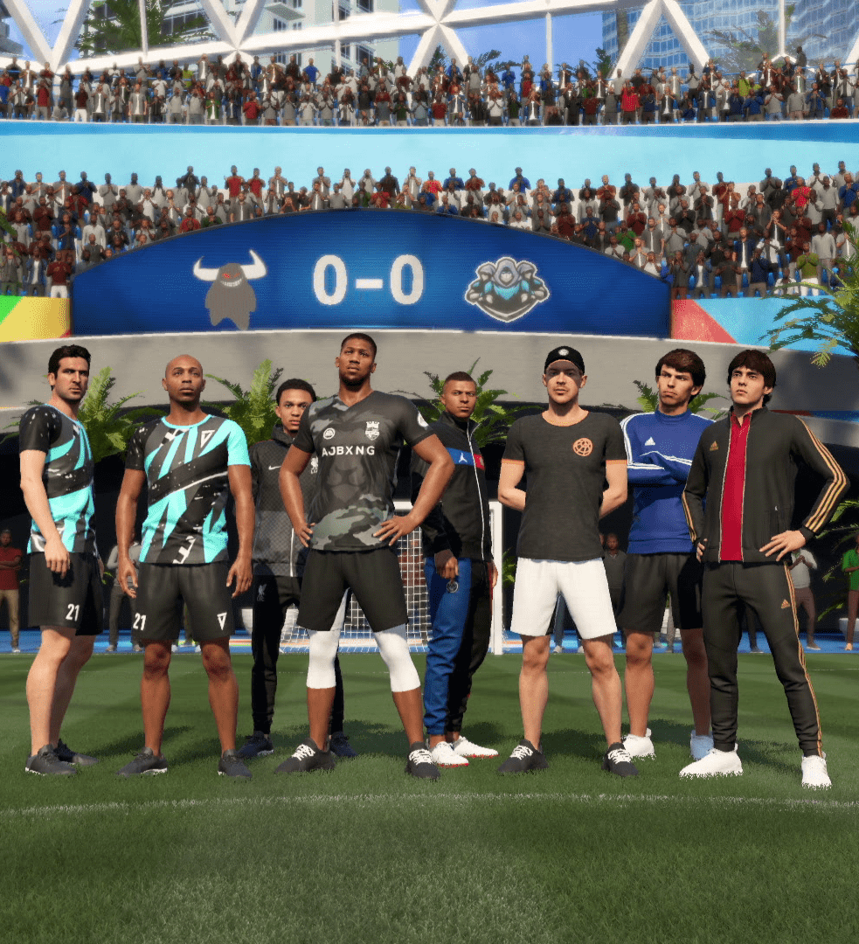

User Journey Mapping in FIFA 21: New Casual Sub-Mode Analysis
In the world of video game development, understanding player behavior is crucial for success. This presentation delves into a comprehensive user journey analysis conducted for FIFA 21's Volta sub-mode. The study aimed to uncover the reasons behind significant player churn soon after launch, focusing on the onboarding process and early gameplay experiences. By leveraging data-driven insights and advanced analytics tools, the team identified key touchpoints and churn factors, leading to impactful design changes and improved player retention.
by Kinjal Majumdar

Slide 2
Player Segmentation and Data Analysis
Core Players
Medium Players
Casual Players
Engaged in 5+ session days after initial activity. These players showed the highest level of commitment and were least likely to churn early.
Participated in 3-5 session days post-initial activity. This group demonstrated moderate engagement but was at risk of churning.
Played less than 3 session days after first activity. This segment was most prone to early churn and required special attention.

Slide 3

Identifying Key Touchpoints
1
Initial Engagement
Players begin their journey with sign-up, avatar creation, and customization. These early stages set the tone for the player's experience.
2
Tutorial and Learning
Users progress through tutorial cinematics and gameplay, introducing them to Volta's unique features and mechanics.
3
Deeper Involvement
Players engage with vanity item purchases, additional cinematics, and their first full game, leading to the "Choose Your Path" decision point.

Slide 4




Visualizing the User Journey
Journey Mapping
A comprehensive fishbone diagram was created to visually represent the user journey across all touchpoints. This tool allowed for easy identification of critical stages and potential pain points.
Segment Comparison
The diagram highlighted differences in progression between core, medium, and casual players, revealing unique patterns and preferences for each segment.
Churn Indicators
By mapping user flow, the team could pinpoint specific stages where players were most likely to disengage, providing valuable insights for targeted improvements.

Slide 5
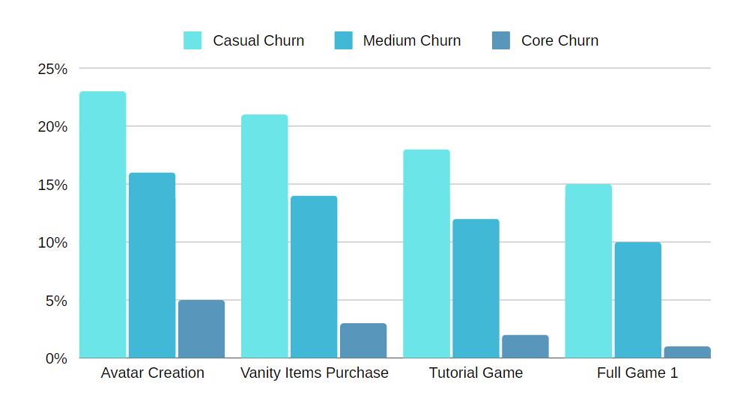
Identifying High-Churn Touchpoints
Touchpoint
Casual Churn
Medium Churn
Core Churn
Avatar Creation
23%
16%
5%
Vanity Items Purchase
21%
14%
3%
Tutorial Game
18%
12%
2%
Full Game 1
15%
10%
1%

Slide 6
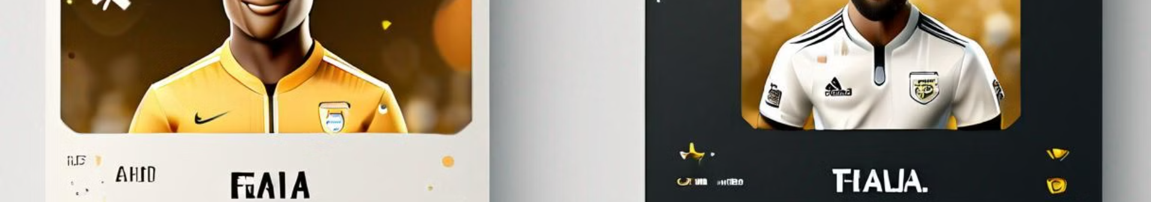
UX Design Improvements
1
Streamlined Onboarding
2
Enhanced Avatar Creation
The team reduced the number of touchpoints from 12 to 6, eliminating unnecessary steps and creating a more focused user experience.
The avatar creation process was simplified and made more engaging, addressing the high churn rate at this crucial early stage.
3
Improved Tutorial Flow
4
Optimized Vanity Items
The tutorial cinematic and gameplay sections were redesigned to be more intuitive and less time-consuming, reducing friction for new players.
The vanity item purchase system was revamped to be more appealing and less intrusive, addressing the churn issue at this touchpoint.

Slide 7




Testing and Results
Casual Player Improvement
19% more casual players reached the final stage of the onboarding process, significantly reducing early churn.
Medium Player Engagement
26% increase in medium players reaching the final stage, indicating a more engaging and streamlined experience.
Core Player Retention
12% more core players completed the onboarding process, further solidifying the loyalty of this key segment.

Slide 8

Lessons Learned and Future Implications
Data-Driven Design
The success of this project underscored the importance of using data analytics to inform game design decisions, leading to more user-centric experiences.
Continuous Iteration
The team recognized the need for ongoing analysis and refinement of the user journey, establishing a framework for future updates and improvements.
Cross-Functional Collaboration
The project highlighted the value of close collaboration between data analysts, UX designers, and game developers in creating successful gaming experiences.
Player Segmentation Insights
Understanding the unique needs and behaviors of different player segments proved crucial in tailoring the onboarding experience and reducing churn across all groups.

